Slide 1
CS1010X Lecture 14:
Intro to Java
Notes:
Lecture 14a video

Slide 2
Why Java?
Why C?
Understand a bit more about object oriented programming
  Cleaner in syntax
  Platform independent as it runs on top of JVM
  Write Once, Run Everywhere™

Slide 3
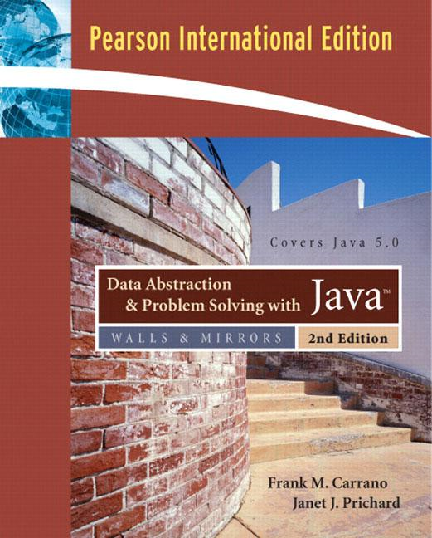
Reference
Data Abstraction &
Problem Solving with Java
https://www.amazon.com/Data-Abstraction-Problem-Solving-Java/dp/0321304284

Slide 4
Overview
Difficulties in learning another language?
Python vs Java
Intro to Java
  How to run Java
  Algorithmic : arithmetic, control, looping
  Data : primitive data, string, array
Useful Java classes

Slide 5
Difficulties?
CS = Algorithm + Data Structure
For here/us, a different language means a different syntax.
  If you think it can be done with your familiar language, it should be possible too with the new one – just google
On the other hand, it could also mean different computational model (declarative vs object-oriented vs functional vs …)
  which you will learn a lot more in the specialized course on principles of programming languages

Slide 6
Key Difference: Types
Java is Static Typed
  Variables need to be declared before used
  Type does not change during runtime
Allocates memory storage

Slide 7
Key Difference: Types
def expt(x, n): # rely on indentation
if n == 0:
return 1
else:
return x * expt(x, n-1)
float expt(float x, int n) { // rely on {}
if (n == 0)
return 1; // this is 1 statement, so no need {}
else { // this pair is redundant for the same reason
return x * expt(x, n-1);
}
}

Slide 8
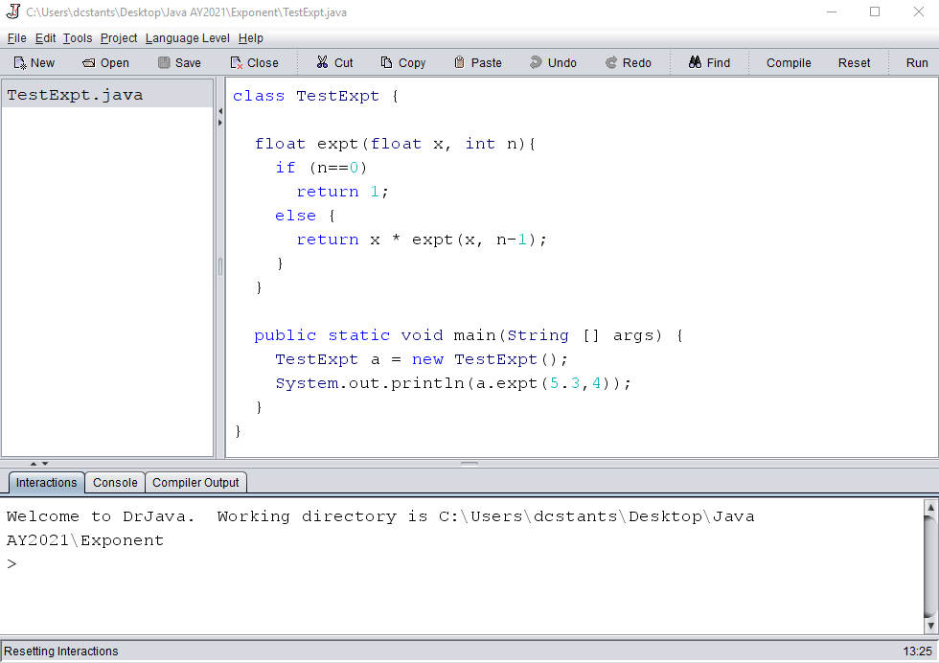
Key Difference: Types

Slide 9
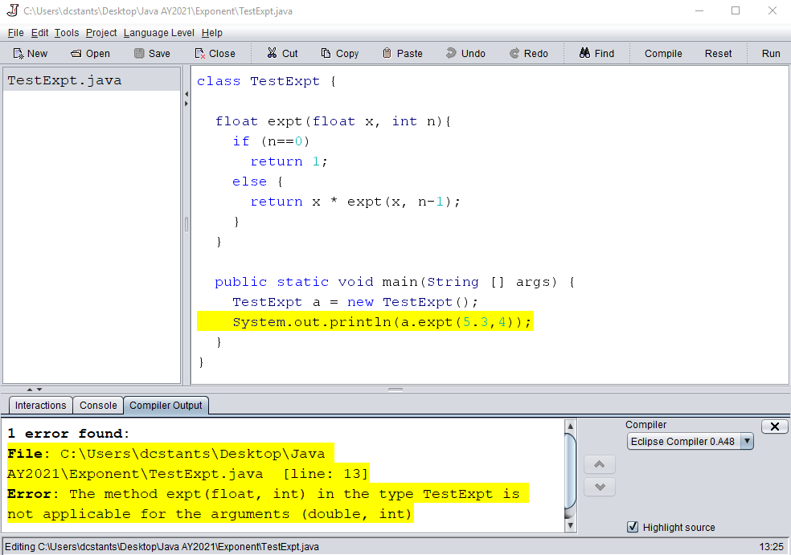
Key Difference: Types

Slide 10
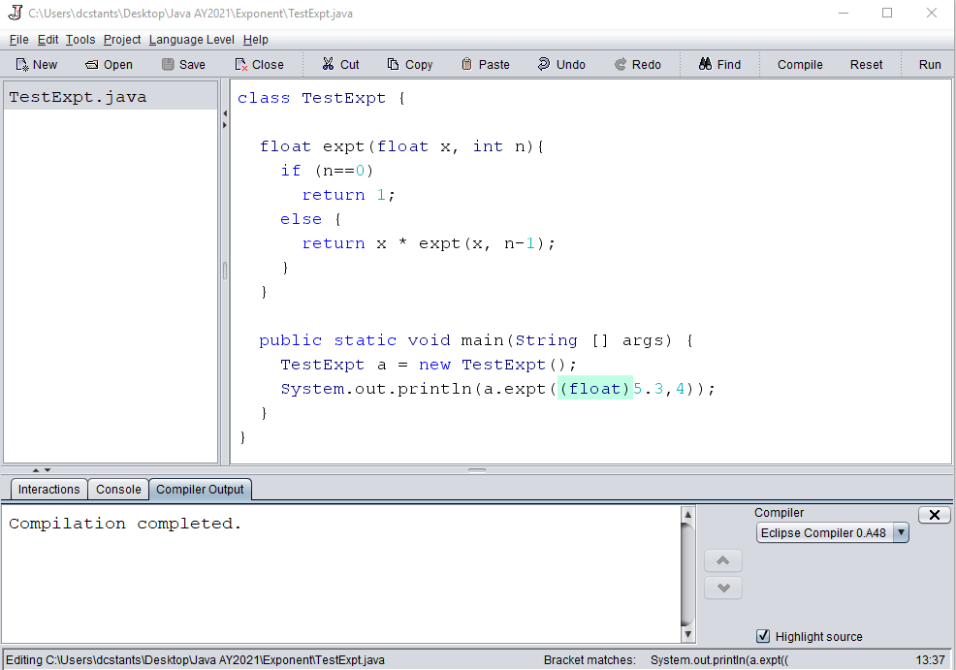
Key Difference: Types

Slide 11
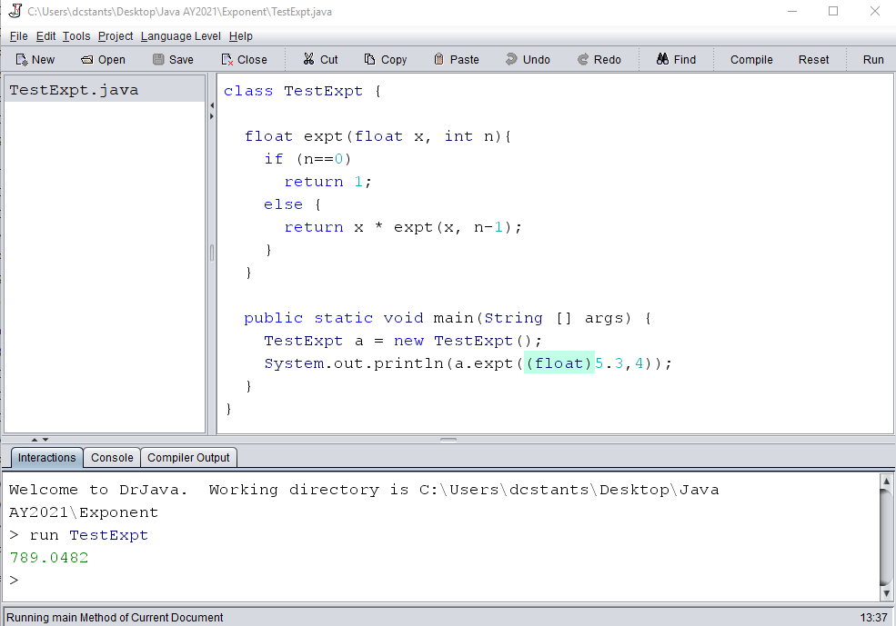
Key Difference: Types

Slide 12
Java vs Python
Java program must be compiled first
Type language – restriction imposed
Rely on { } rather than indentation, and “;”
Class structure
int/int is an integer
Finite precision (over- under-flow)
…as you read/learn, you discover more

Slide 13
Intro to Java (properly)
Most materials taken from
  https://www.w3resource.com/java-tutorial/
Notes:
Lecture 14b video

Slide 14
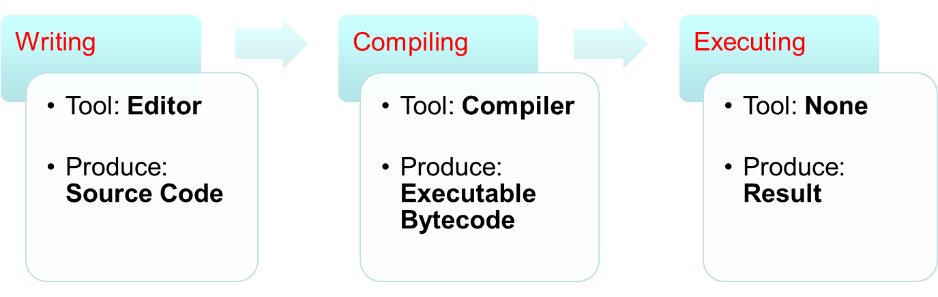
Intro to Java: Program Life Cycle
Compilation Error
Runtime Error
Logic Error

Slide 15
Intro to Java: Program Life Cycle
Writing / Editing Program
  Any text editor; 1 file has 1 class
  Source code must have a .java extension
    e.g. Hello.java
Compiling Program
  Use Java compiler javac
    e.g. "javac Hello.java"
  Compiled binary has .class extension:
    e.g. Hello.class
  The binary is also known as Java Executable Bytecode
Executing Binary
  Run on a Java Virtual Machine (JVM)
    e.g. "java Hello" (leave out the .class extension)

Slide 16
Intro to Java: Program Life Cycle
Compilation Error
Runtime Error
Logic Error
IDE: Integrated Development Environment, e.g. DrJava

Slide 17
Key Difference: Types
Editing
window

Slide 18
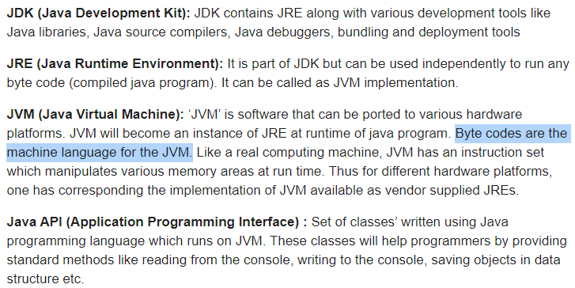
Intro to Java : Terminologies
Notes:
Not in video

Slide 19
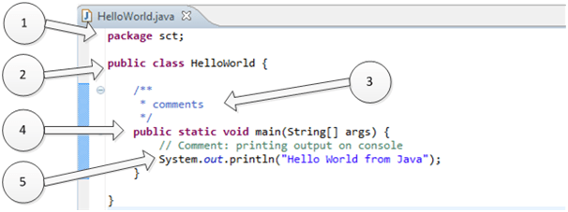
Intro to Java: Program Structure
import java.util.Scanner;
Import… packages/libraries to be imported
Keyword class to declare a class. Indicate public, protected, private etc.
Comment: use // for a single line, or /* */ for a block
Main function to start the execution

Slide 20
Intro to Java: Program Structure
Library in Java is known as package
  Packages are organized into hierarchical grouping
  E.g., the “System.out.println" is defined in the package "java.lang.system"
    i.e. "lang" (language) is a group of packages under "java" (the main category) and "system" is a package under "lang"
To use a library, the appropriate package should be imported
  Using the import XXXXXX;
  All packages under a group can be imported with a "*" wildcard
Packages under "java.lang" are imported by default
  i.e. the import statement in this example is optional
Notes:
Not in video

Slide 21
Intro to Java: Function Declaration
public static float expt(float x, int n) {…}
access
modifier
return type
method name
parameter(s)
method body
private void MMM (void) {…}
Need to specify return type and the types of each parameter.
Use void for return type if it returns nothing
Compulsory to return a value; returned value must match return type. If void in return type, just do a return; at the end of the function
Likewise, put void in parameters if the function does not have any parameters

Slide 22
Intro to Java: main function
public static void main(String [] args)
{ … }
When program is run, the special method main is found and the execution of the program begins there.
String arguments can be passed to the main method as an array of Strings

Slide 23
Intro to Java: IDE
  See https://www.w3resource.com/java-tutorial/download-and-Install-JDK-Eclipse-IDE.php, or
  Check out https://hackr.io/blog/best-java-ides for popular IDEs used for Java development
  Use your nusnet account to apply for one SOC Unix account to use: https://mysoc.nus.edu.sg/~newacct
    use: javac prog.java to compile your program
    use: java prog to execute your program (starting at main)

Slide 24
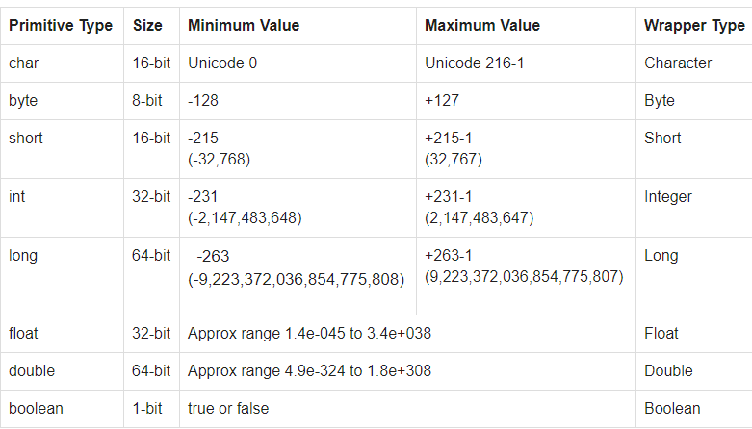
Intro to Java: Primitive Data Types

Slide 25
Intro to Java: Operators - arithmetic
() | Parentheses Grouping | Left-to-right
++, -- | Postfix incrementor/decrementor | Right-to-left
++, -- +, - | Prefix incrementor/decrementor Unary +, - | Right-to-left
% | Remainder of integer division | Left-to-right
*, / | Multiplication, Division | Left-to-right
+, - | Addition, Subtraction | Left-to-right
= += -= *= /= %= | Assignment Operator Shorthand Operators | Right-to-left
Higher Precedence
Evaluation of numeric expression:
  Determine grouping using precedence
  Use associativity to differentiate operators of same precedence
  Data type conversion is performed for operands with different data types

Slide 26
Intro to Java: Operators - arithmetic
When operands of an operation have differing types:
  If one of the operands is double, convert the other to double
  elif one of them is float, convert the other to float
  elif one of them is long, convert the other to long
  else, convert both into int
When value is assigned to a variable of differing types:
  Widening (Promotion): e.g. int is assigned to a double variable
    Value has a smaller range compared to the variable
    Can be converted automatically
  Narrowing (Demotion): e.g. double is assigned to an integer variable
    Value has a larger range compared to the variable
    Must do explicit type casting

Slide 27
Intro to Java: Operators - arithmetic
Conversion (promotion):
double d;
int i;
i = 12;
d = i / 10; // resulted in 1.0, instead of 1.2
Type casting (demotion):
The “(
Syntax:
(datatype) value
Effect:
The value is converted explicitly to the data type stated if possible.
double d;
int i;
d = 1.2;
i = (int) d; // resulted in 1

Slide 28
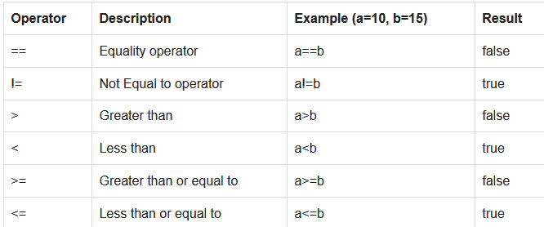
Intro to Java: Operators - Relational
  Operands are variables/values that can be compared directly

Slide 29
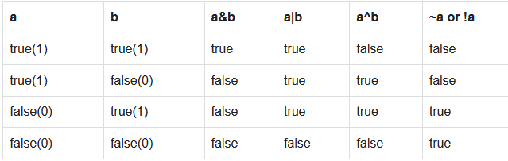
Intro to Java: Operators - Logical
  Operands are Boolean variable / expression
and
or
xor
not

Slide 30
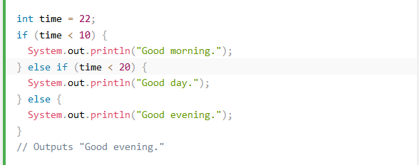
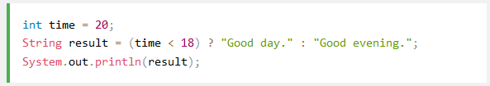
Intro to Java: Flow control – if-else

Slide 31
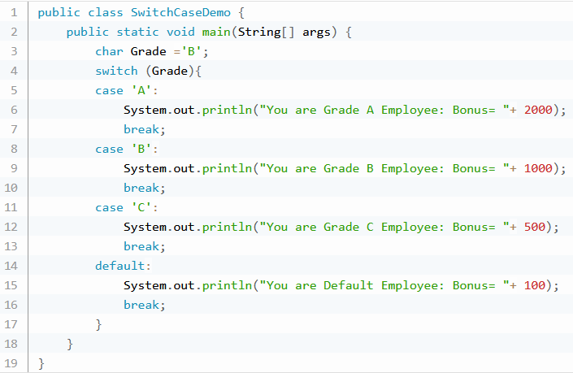
Intro to Java: Flow control - switch

Slide 32
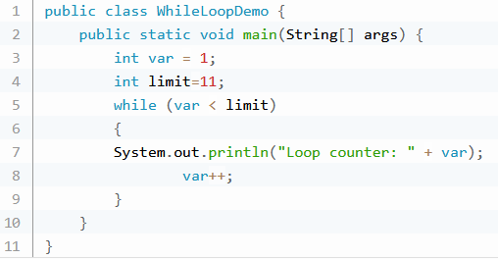
Intro to Java: Flow control - while
while (a > b) {
... //body
}
do {
... //body
} while (a > b);

Slide 33
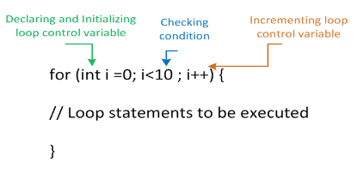
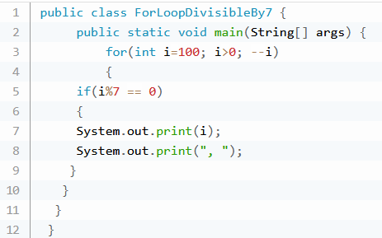
Intro to Java: Flow control - for
class body
method body
for body
if body

Slide 34
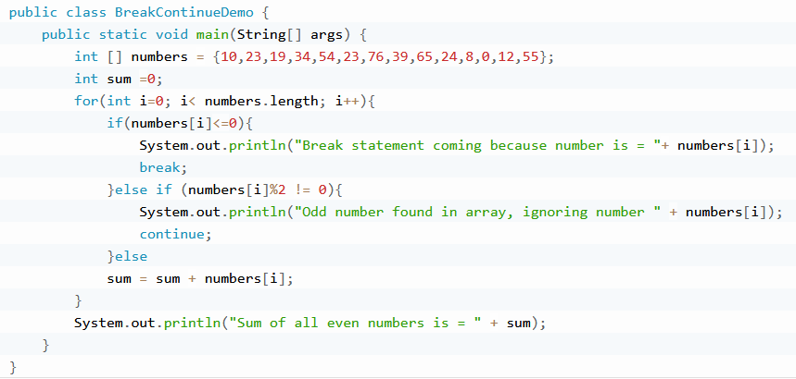
Intro to Java: Flow control break continue

Slide 35
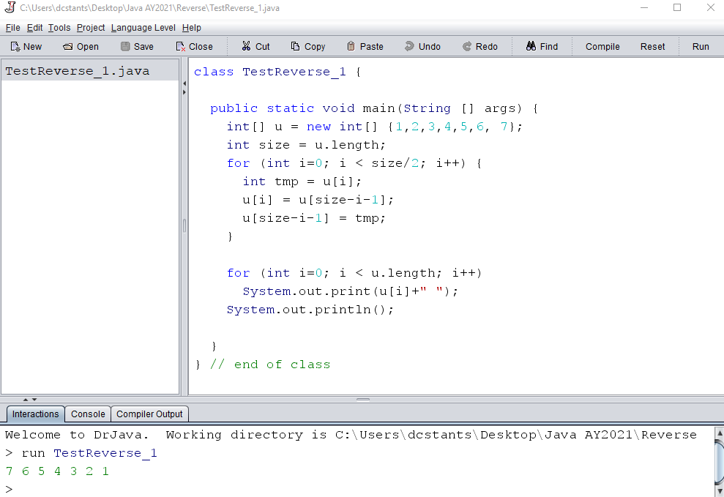
Eg. reverse (iterative #1)

Slide 36
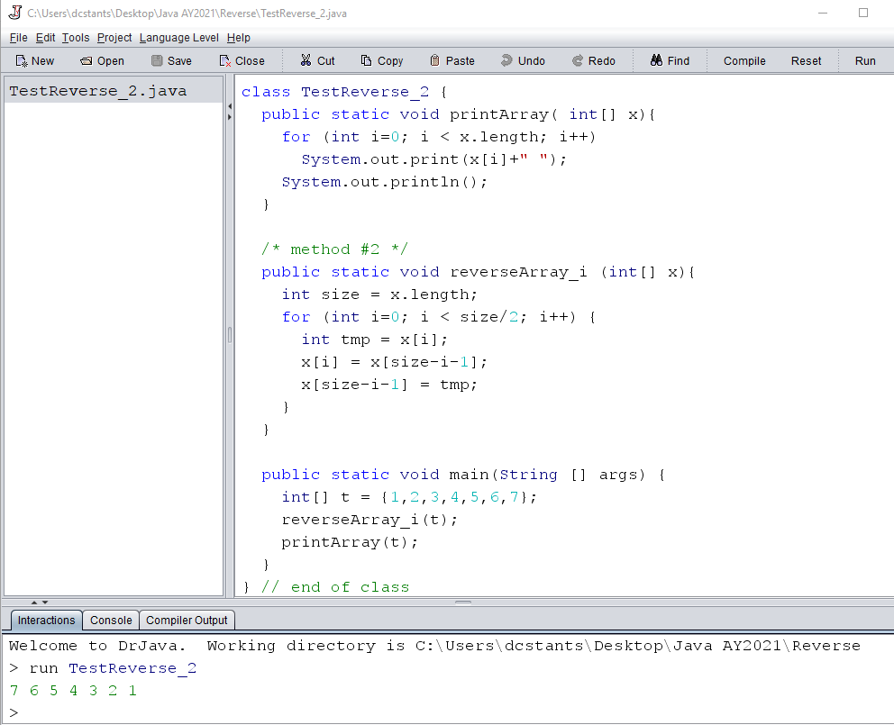
Eg. reverse (iterative #2)

Slide 37
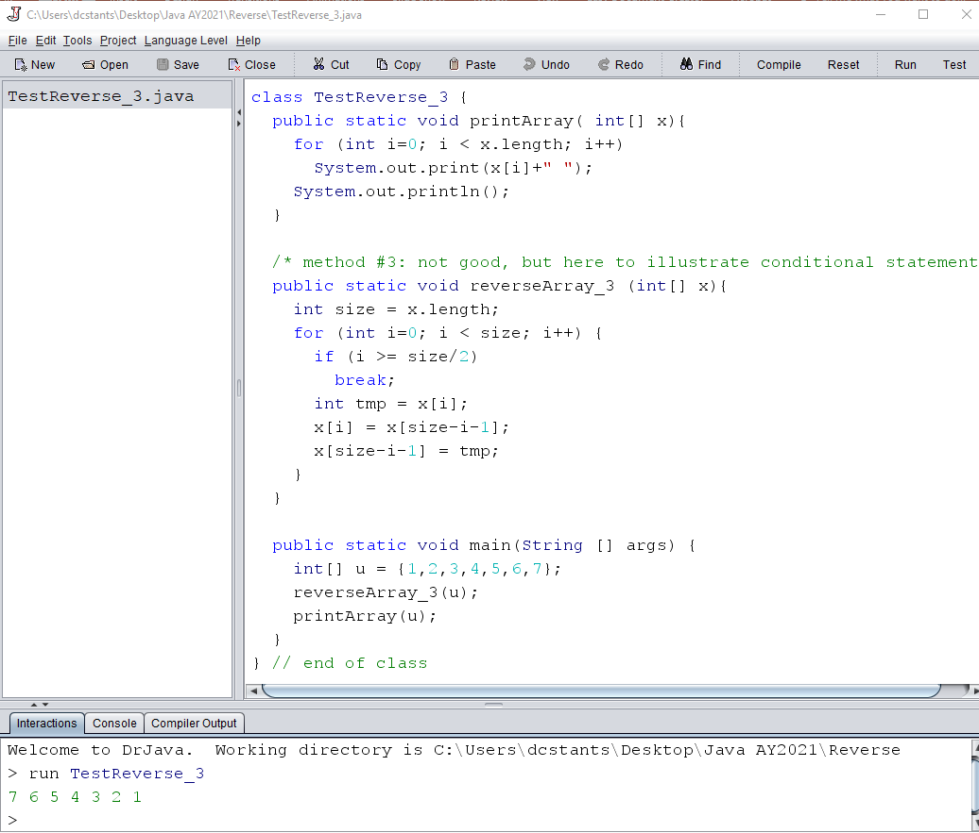
Eg. reverse (iterative #3)

Slide 38
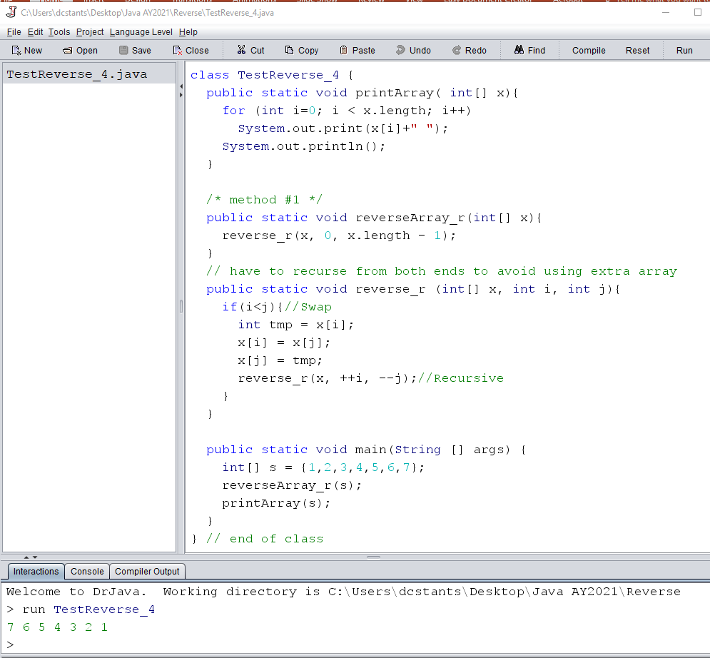
Eg. reverse (recursive)

Slide 39
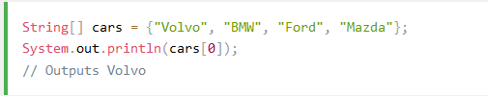



Array (vs tuple / list in Python)

Slide 40


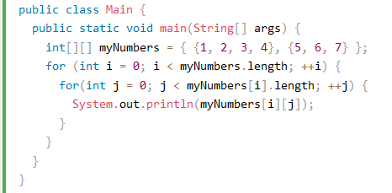
Array (vs tuple / list in Python)
1D Array
Multidimensional Array

Slide 41


Scanner Class (input)
import java.util.Scanner;
//Declaration of Scanner "variable"
Scanner scVar = _initialization_;
//Functionality provided
scVar.nextInt();
scVar.nextDouble();
......

Slide 42
Scanner Class (input)
import java.util.Scanner;
class Temperature {
public static void main( String[] args ) {
double fahrenheit, celcius;
Scanner myScanner = new Scanner( System.in );
System.out.println( "Enter temperature in Fahrenheit:" );
fahrenheit = myScanner.nextDouble();
celcius = ( 5.0 / 9 ) * ( fahrenheit – 32 );
System.out.println( "Celcius: " + celcius );
}
}

Slide 43
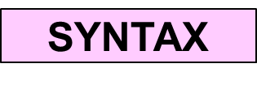
printf (output)
The format string contains normal characters and a no. of specifier
  Specifier starts with a percent sign (%)
  Value of the appropriate type must be supplied for each specifier
Common specifiers and modifiers:
%d | for integer value
%f | for double floating point value
%s | for string
%b | for boolean value
%c | for character value
%[-][W].[P]type
-: For left alignment
W: For width
P: For precision

Slide 44
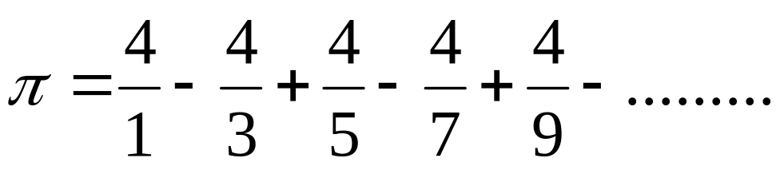
Approximating
import java.util.*;
class ApproximatePI {
public static void main( String[] args ) {
int i, nTerms, sign = 1, denom = 1;
double PI = 0;
Scanner myScanner = new Scanner( System.in );
System.out.println( "Enter number of terms:" );
nTerms = myScanner.nextInt();
for ( i = 0; i < nTerms; i++) {
PI += 4.0 / denom * sign;
sign *= -1;
denom += 2;
}
System.out.printf( "PI = %.6f\n", PI );
}
}

Slide 45

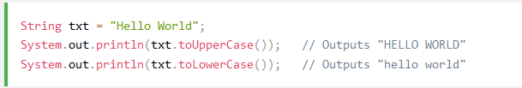

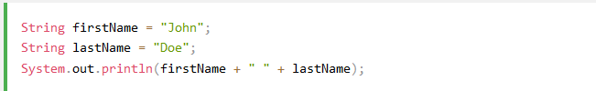
String Class
https://www.w3schools.com/java/java_ref_string.asp

Slide 46
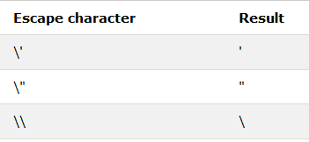

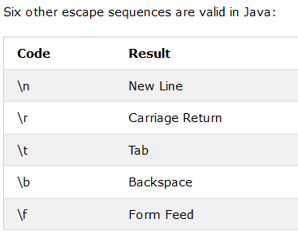
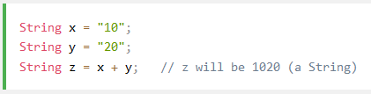
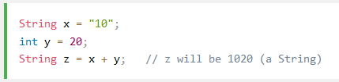
String Class
https://www.w3schools.com/java/java_ref_string.asp

Slide 47
Question of the Day
Congratulations, you’ve just learnt a new language in one (?) hour! ☺
Now convince yourself that you can reproduce in Java what you can do in Python
Write in Java (both recursive and iterative) for:
  Factorial
  Exponent (done in one recursive version)
  etc.

